Slide 1
Current Condition
What is the species’ current condition?
Empirical description
Involves measures of demographics, distribution, diversity and factors that influence them
Includes probable explanations for past and ongoing changes
What are the negative and beneficial factors that have led to the current condition?
Notes:
Now we are scaling up to the SPECIES scale for current condition. (We discussed individual and population current condition this morning.)
Empirical description of the current condition of the species’ habitat and demographics, and the probable explanations for past and ongoing changes in abundance and distribution within the areas representative of the geographic, genetic, or life history variation across the species’ range.

Slide 2
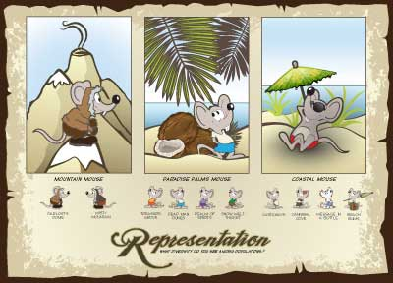
Current Condition
What are possible metrics for the species’ current condition?
Representation
Number or percent of ecological settings across the species’ range based on geographic, genetic, ecological, or niche diversity
Notes:
Characterize the results around the 3Rs, because this is current condition and not a projection, we suggest you focus on the metrics for each of the “Rs”. Representation . . .READ DEFINITION AND RELATE TO THE GRAPHIC. What can you say about representation in the Island Mouse, given what we know about their populations and ecological settings?

Slide 3
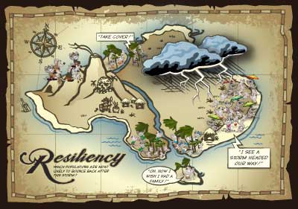
Current Condition
What are possible metrics for the species’ current condition?
Resilience
Population sizes and population trends
Connectivity and meta-population dynamics
Intermediate measures (means to resilience):
Habitat extent, distribution and connectivity
Threat abatement
Notes:
Resilience…READ THE DEFINITION OUT LOUD. Look at the Resilience poster together and discuss what it is portraying.
Based upon this understanding, what do we know about resiliency in the Island Mouse?

Slide 4
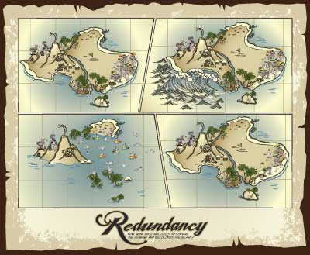
Current Condition
What are possible metrics for the species’ current condition?
Redundancy
Number of populations and their distribution within ecological settings or geographical areas
Notes:
And redundancy. READ THE DEFINITION OUT LOUD. Look at the Redundancy poster together and discuss what it depicts. Can we make some generalized statements about Redundancy in the Island Mouse?

Slide 5

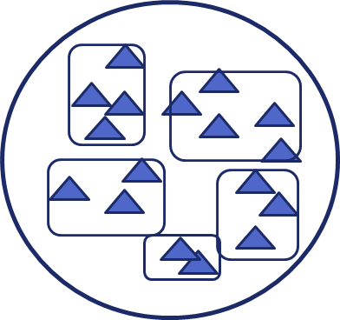
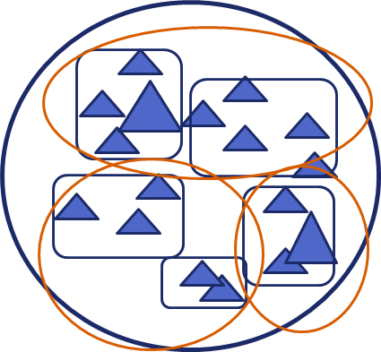
Defining Population Structure
Current Condition
One population
Multiple Populations
Metapopulations
= individual
Notes:
When we discussed Population Needs yesterday, we considered population structures that would support long term persistence of the species (what they need).
Now, in Current Condition, we need to describe what structure the populations HAVE. This may vary for populations across the range of the species.

Slide 6
Core Conceptual Model
Current Condition
Habitat
Demographics
Population Resilience
Notes:
NOW, given our basic core model from yesterday, lets think about how we can use it to explore Cause and Effect.

Slide 7
CCM with Causes Expanded
Current Condition
Ongoing Conservation
Management
Environmental Stressor 1
Habitat
Demographics
Population Resilience
Environmental Stressor 2
Exotic Species
(Other Stressors)
Unpredictable Systematic Change (e.g., Climate Change)
Notes:
Lets look at POSSIBLE reasons WHY we see the CHANGES IN HABITAT
This view expands the Anthropogenic and Natural REASONS (causes) node.
First you have your typical Environmental Stressors that act on habitat conditions (there could be many).
Next is Exotic Species, or Other Factors, that can act either on the habitat or directly on the individuals (through lethal means like predation or could be hybridization or disease).
Climate change may act on the demographics through effects on habitat, directly on demographics??, or suppress or increase the effects, positive or negative, of stressors or exotic species.
Similarly conservation management are positive actions that may act on habitat, directly on indivduals, or decrease the effects of environmental stressors, including exotic species.

Slide 8
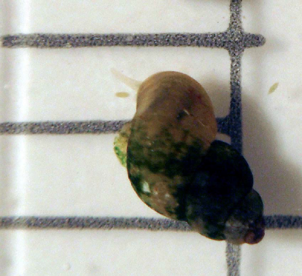
Page Springsnail SSA (Pyrgulopsis morrisoni)
Current Condition
Photo Credit: Drew Pearson (ASU) and Stuart Wells (Phoenix Zoo).
Notes:
Let’s look at the Page Springsnail example to better understand how to develop current condition.

Slide 9
Current Condition
Species’ Ecology
Endemic to a complex of springs along Oak Creek and Spring Creek in Yavapai County, central Arizona.
Occurs in emergent springs supported by free-flowing stream water discharged from a regional aquifer.

Slide 10
Current Condition
Species’ Ecology
Critical factors
spring discharge (water quantity),
water quality,
free-flowing spring ecosystems,
firm substrate and aquatic vegetation
If reliable flow, coupled with adequate water depth, substrates, and suitable water quality, we expect springsnails to survive and thrive.

Slide 11
Current Condition
Currently occurs in 10 springs each thought to support independent populations, approximately the same as its known historical distribution
8 on AGFD hatchery land
2 on private land

Slide 12
Current Condition
It is believed extirpated from two spring sites.
Anthropogenic modification of spring sites through water contamination, springhead modification, impoundment of spring runs, and aquatic vegetation removal caused historical habitat loss within the range of the Page springsnail.

Slide 13
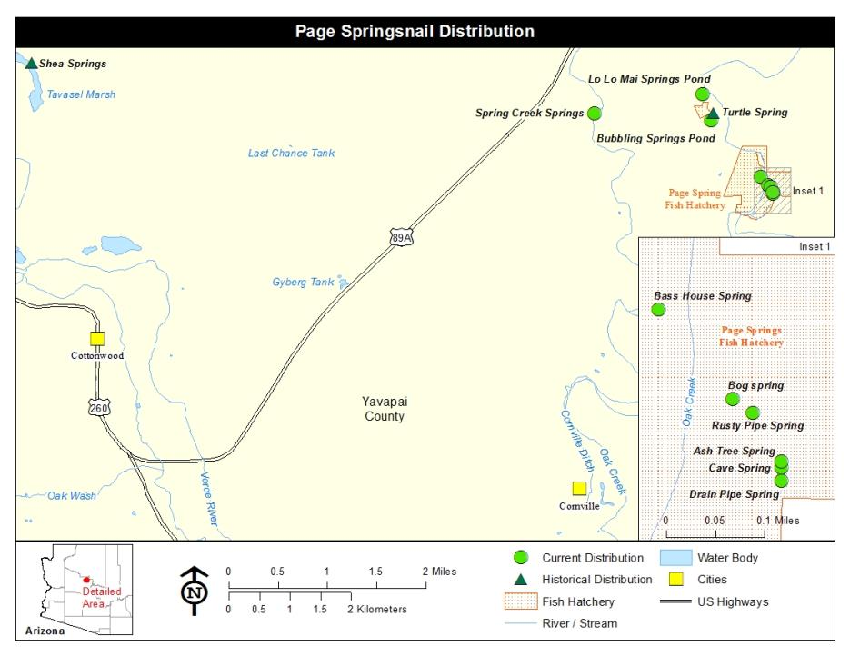

Slide 14
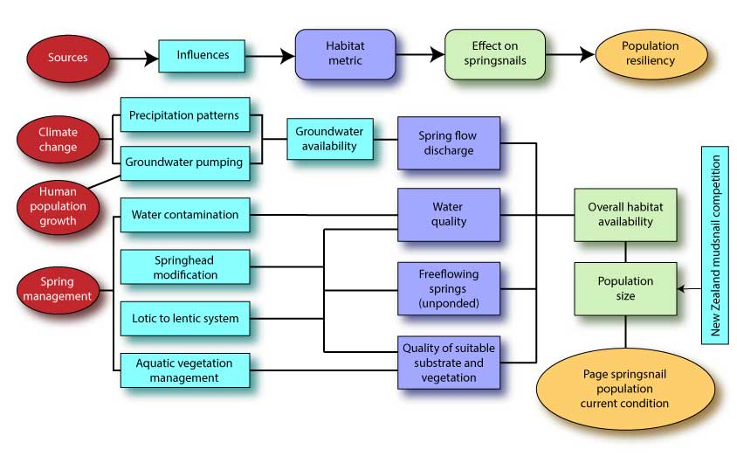
Influence Diagram for Page Springsnail
Notes:
Walk the class through this diagram – start by pointing out the habitat metrics first (their familiar point of reference).
Can you see the basic core conceptual diagram model buried in this more complex model?
Then ask, what influences the quality and quantity of those habitat metrics (point out the boxes to the left, if they don’t immediately respond!).

Slide 15
Current Condition
EXERCISE 7.
Influence Diagrams
Ongoing Conservation
Management
Environmental Stressor 1
Population Resilience
Habitat
Demographics
Environmental Stressor 2
Exotic Species
(Other Stressors)
Unpredictable Systematic Change (e.g., Climate Change)
Notes:
Develop conceptual models for population resilience, and then scale it up to Ecological Setting. You will end up with a conceptual model for each population and for the coastal, paradise palms, and mountain Ecological Settings.
Go back to Exercise 3 to build from that model (or start a new one). Add stressors to the left…
To create the Ecological Settings conceptual models, have three coaches (one for each Ecological Setting group) use the mental modeler with a projector and have the population members contribute information from their CMs to create a model that fits all of the populations in their Ecological Setting.

